Slide 1

This
Understanding the "this" keyword in JavaScript
SoftUni Team
Technical Trainers
Software University
http://softuni.bg

Slide 2
Table of Content
What Is "This"?
Usages Of "This" Keyword
In Objects
In Browser
In Events
"This" In Functions
Explicit Binding

Slide 3
Have a Question?
sli.do
#js-advanced

Slide 4
this
Introduction to "this"

Slide 5
Interpreter and Execution Context
Interpreter reads and executes code line by line
Execution Context
The scope in which the line is being executed
The JavaScript runtime maintains a stack of these execution contexts
The execution context present at the top of this stack is currently being executed

Slide 6
What is Function Context?
The function context is the object that owns the currently executed code
Function context === this object
Depends on how the function is invoked
Global invoke: func()
object.function()
domElement.event()
Using call() / apply() / bind()

Slide 7
this
Special keyword in JavaScript
Its value is based on the context
There are differences in strict mode
The object that this refers to changes every time execution context is changed

Slide 8
"This" Refers to The Global Object
When used alone, the owner is the Object [global]
console.log(this === global); // false
function solve() {
return this;
}
console.log(solve() === global) // true

Slide 9

"This" Keyword in the Browser
let b = "b";
console.log(this.b); //undefined
var a = "a";
console.log(this.a); //a
function foo() {
console.log("Simple function call");
console.log(this === window); // true
} foo();

Slide 10
"This" in Strict Mode
Strict Mode
No Strict Mode
function solve() {
"use strict";
console.log(this);
}
solve(); // undefined
function solve() {
console.log(this);
} solve();
// Object [global]

Slide 11

"This" in Different Context

Slide 12
"This" in a Method
Refers to the owner of the method
let person = {
firstName: "Peter",
lastName: "Ivanov",
fullName: function(){
return this.firstName + " " + this.lastName
},
whatIsThis: function(){ return this }
} console.log(person.fullName()); // Peter Ivanov
console.log(person.whatIsThis()); // person

Slide 13
"This" Refers to the Parent Object
function foo() {
console.log(this === global);
}
let user = {
count: 10,
foo: foo,
bar: function () { console.log(this === global); }
}
user.foo() // false
let func = user.bar;
func() // true
user.bar() // false

Slide 14
In Events
In event handlers, this is set to the element the event fired from
element.addEventListener("click", function(e) {
console.log(this === e.currentTarget); // Always true
});

Slide 15
"This" in Classes
The value of this refers to the newly created instance
class Person {
constructor(fn, ln) {
this.first_name = fn;
this.last_name = ln;
this.displayName = function () {
console.log(`Name: ${this.first_name} ${this.last_name}`);
} } };
let person = new Person("John", "Doe");
person.displayName(); // John Doe

Slide 16
f(x)
"This" in Functions

Slide 17
"This" with Inner Functions
this variable is accessible only by the function itself
function outer() {
console.log(this); // Object {name: "Peter"}
function inner() {
console.log(this); // Window
}
inner();
}
const obj = { name: 'Peter', func: outer }
obj.func();

Slide 18
"This" with Arrow Functions
this retains the value of the enclosing lexical context
function outer() {
const inner = () => console.log(this);
inner();
}
const obj = {
name: 'Peter',
func: outer
};
obj.func(); // Object {name: "Peter"}

Slide 19
this
this
this
this
this
this
this
this
this
this
Explicit Function Binding
call, apply, bind

Slide 20
Explicit Binding
Occurs when call(), apply(), or bind() are used on a function
Forces a function call to use a particular object for this binding
function greet() {
console.log(this.name);
}
let person = { name:'Alex' };
greet.call(person, arg1, arg2, arg3, ...); // Alex

Slide 21
Changing the Context: Call
Calls a function with a given this value and arguments provided individually
const sharePersonalInfo = function (...activities) {
let info = `Hello, my name is ${this.name} and`+ + `I'm a ${this.profession}.\n`;
info += activities.reduce((acc, curr) => {
let el = `--- ${curr}\n`;
return acc + el;
}, "My hobbies are:\n").trim(); return info;
} // Continues on the next slide…

Slide 22
Changing the Context: Call
const firstPerson = { name: "Peter", profession: "Fisherman" };
console.log(sharePersonalInfo.call(firstPerson, 'biking', 'swimming','football'));
// Hello, my name is Peter.
// I'm a Fisherman.
// My hobbies are:
// --- biking
// --- swimming
// --- football

Slide 23
Changing the Context: Apply
Calls a function with a given this value, and arguments provided as an array
apply() accepts a single array of arguments, while call() accepts an argument list
If the first argument is undefined or null a similar outcome can be achieved using the array spread syntax

Slide 24
Apply() - Example
const firstPerson = {
name: "Peter",
prof: "Fisherman",
shareInfo: function () {
console.log(`${this.name} works as a ${this.prof}`);
}
};
const secondPerson = { name: "George", prof: "Manager" };
firstPerson.shareInfo.apply(secondPerson);
// George works as a Manager

Slide 25
Changing the Context: Bind
The bind() method creates a new function
Has its this keyword set to the provided value, with a given sequence of arguments preceding any provided when the new function is called
Calling the bound function generally results in the execution of its wrapped function

Slide 26
Bind - Example
const x = 42;
const getX = function () {
return this.x;
}
const module = {x , getX };
const unboundGetX = module.getX;
console.log(unboundGetX()); // undefined
const boundGetX = unboundGetX.bind(module);
console.log(boundGetX()); // 42

Slide 27
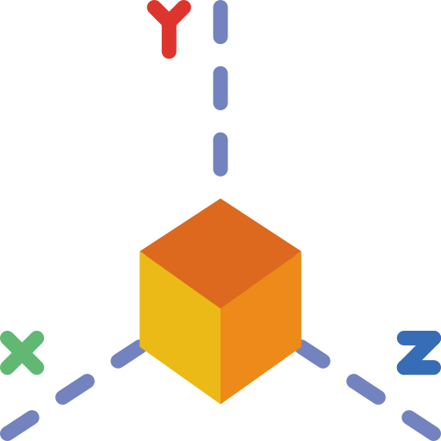
Problem: Area and Volume Calculator
The functions area and vol are passed as parameters to your function
function area() {
return this.x * this.y;
};
function vol() {
return this.x * this.y * this.z;
};

Slide 28
Problem: Area and Volume Calculator
Calculate the area and the volume of figures, which are defined by their coordinates (x, y and z), using the provided functions
'[
{"x":"1","y":"2","z":"10"},
{"x":"7","y":"7","z":"10"},
{"x":"5","y":"2","z":"10"}
]'
[
{ area: 2, volume: 20 },
{ area: 49, volume: 490 },
{ area: 10, volume: 100 }
]

Slide 29
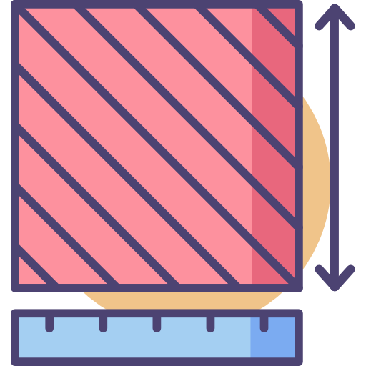
Solution: Area and Volume Calculator
function solve(area, vol, input) {
let objects = JSON.parse(input);
function calc(obj) {
let areaObj = Math.abs(area.call(obj));
let volumeObj = Math.abs(vol.call(obj));
return { area: areaObj, volume: volumeObj }
}
return objects.map(calc);
}

Slide 30
Problem: Person
Return an object with firstName, lastName and fullName
If firstName or lastName are changed, then fullName should also be changed
If fullName is changed, then firstName and lastName should also be changed
let person = new Person("Albert", "Simpson");
console.log(person.fullName);//Albert Simpson
person.firstName = "Simon";
console.log(person.fullName);//Simon Simpson

Slide 31

Solution: Person
function Person(first, last) {
this.firstName = first;
this.lastName = last;
Object.defineProperty(this, "fullName", {
set: function(value) {
// ToDo
},
get: function() {
// ToDo
}
}
);
}

Slide 32

Practice
Live Exercise in Class (Lab)

Slide 33

Summary
Functional Context
What this refers to depends on where and how the function that is being executed is called
bind, apply and call are all functions that can be used to explicitly set the value of this
…
…
…

Slide 34
https://softuni.bg/courses/js-applications

Slide 35












SoftUni Diamond Partners

Slide 36




SoftUni Organizational Partners

Slide 37




Trainings @ Software University (SoftUni)
Software University - High-Quality Education and Employment Opportunities
softuni.bg
Software University Foundation
http://softuni.foundation/
Software University @ Facebook
facebook.com/SoftwareUniversity
Software University Forums
forum.softuni.bg

Slide 38

License
This course (slides, examples, demos, videos, homework, etc.) is licensed under the "Creative Commons Attribution-NonCommercial-ShareAlike 4.0 International" license

